Slide 1
WEB TRAFFIC PREDICTION
Guides:
Deepika and Nidhi ma’am
TEAM MEMBERS
BOYAPATI SASHIDHAR PERUMALLA GANESH MUSKU VAMSHI REDDY NERELLA GURU TARUN SUREDDY SAI SATWIK REDDY

Slide 2
Problem Statement
01
The problem of forecasting the future values of multiple time series, as it has always been one of the most challenging problems in the field. More specifically, on the problem of forecasting future web traffic for approximately 145,000 Wikipedia articles.

Slide 3
Modules used
02
LSTM:
It is an artificial recurrent neural network.
It can process single data points as well as sequences of data.
Eg: images, speech and video
LSTM networks are well suited to classifying, processing and making predictions based on time series data.

Slide 4
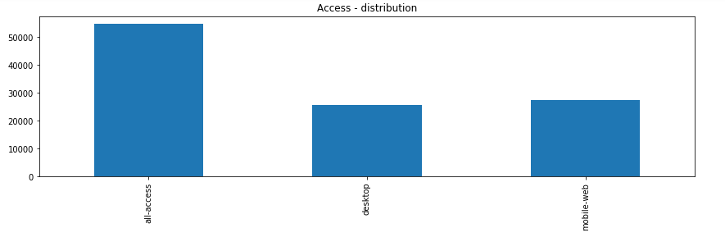
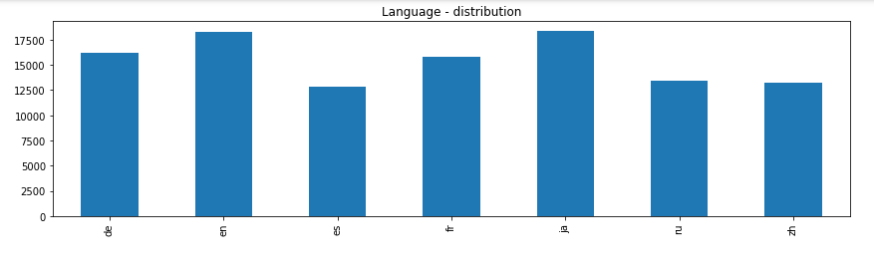
Code Snippets
train = pd.read_csv("E:\\Project\\web-traffic-time-series-forecasting\\train_1.csv")
empty_sample = train[train.isnull().any(axis=1)]
df_cleaned=train.dropna()
fig, axs = plt.subplots(3,1,figsize=(12,12))
page_details["lang"].value_counts().sort_index().plot.bar(ax=axs[0])
axs[0].set_title('Language - distribution')
page_details["access"].value_counts().sort_index().plot.bar(ax=axs[1])
axs[1].set_title('Access - distribution')
page_details["type"].value_counts().sort_index().plot.bar(ax=axs[2])
03

Slide 5
#Training LSTM
from tensorflow.keras.models import Sequential
from tensorflow.keras import layers
from tensorflow.keras.layers import Dense, LSTM,RNN
from tensorflow.keras.optimizers import RMSprop
from tensorflow.keras import optimizers
regressor = Sequential()
regressor.add(LSTM(units = 128, activation = 'linear', return_sequences=True,input_shape = (None, 1)))
regressor.add(LSTM(units = 64, activation = 'linear'))
regressor.add(Dense(units = 1))
regressor.compile(optimizer = 'adam', loss = 'mse')
# Fitting the RNN to the Training set
regressor.fit(X_train, y_train,
epochs=25,
batch_size=300,
validation_split=0.2)
04

Slide 6
# Getting the predicted Web View
inputs = X_test
inputs = np.reshape(inputs,(-1,1))
inputs = sc.transform(inputs)
inputs = np.reshape(inputs, (inputs.shape[0], 1, 1))
y_pred = regressor.predict(inputs)
y_pred = sc.inverse_transform(y_pred)
#Visualising Result
plt.figure
plt.plot(y_test, color = 'red', label = 'Real Web View')
plt.plot(y_pred, color = 'blue', label = 'Predicted Web View')
plt.title('Web View Forecasting'+model.iloc[j,0])
plt.xlabel('Number of Days from Start')
plt.ylabel('Web View')
plt.legend()
plt.show()
mse = ((y_pred - y_test) ** 2).mean()
print('The Mean Squared Error of our forecasts is {}'.format(round(mse, 2)))
print('The Root Mean Squared Error of our forecasts is {}'.format(round(np.sqrt(mse), 2)))
05

Slide 7
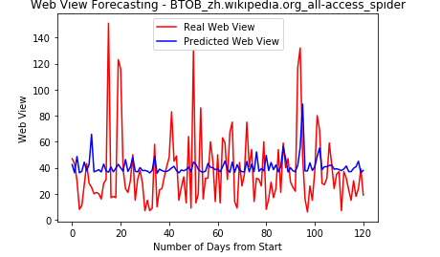
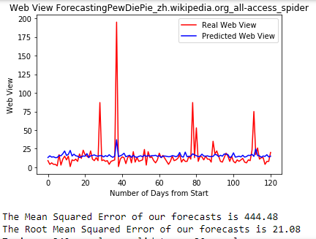
Results Obtained
06

Slide 8
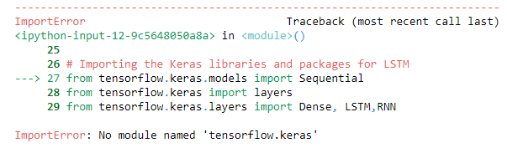
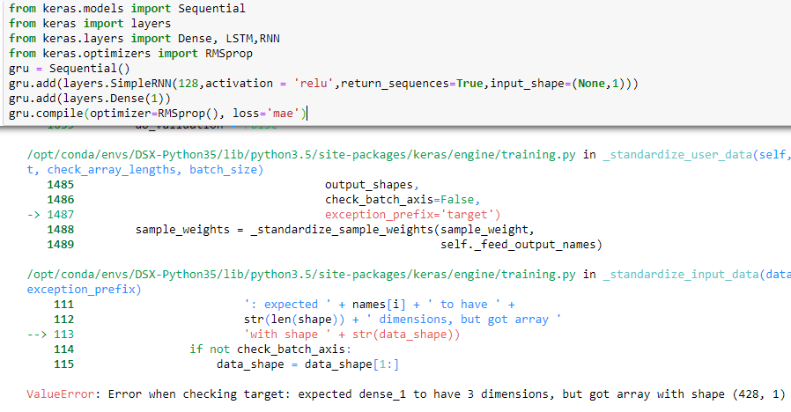
Problem faced
07

Slide 9
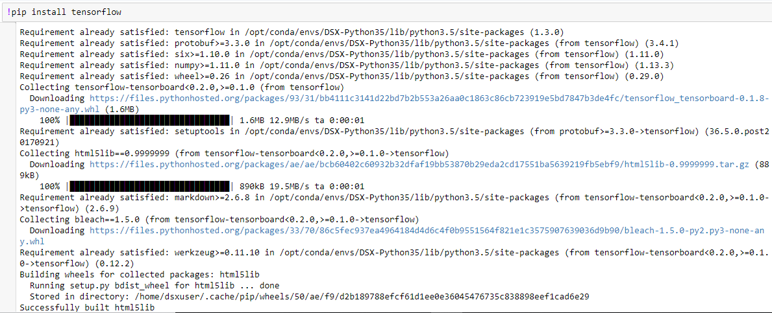
Method used to solve the problem
08

Slide 10
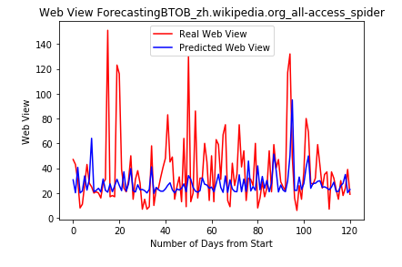
Conclusion
09
The project is about predicting the web traffic of Wikipedia pages.
We can also find the traffic of the particular sites based on analysis of previous data
So, that we can manage the servers according to our need.
This helps in good resource management.
Similarly, We can also use this method for predicting many time series related problems like gold price estimation and shopping estimation which helps the customers as well as vendors.

Slide 11
Thank you
Presented By:
Dream Crushers

